Slide 1
Snowflake Training

Slide 2
Agenda
Snowflake Pricing
Table Structures
Micro-partitions
Data Clustering
Search Optimization and clustering
LAB
Security
Authentication
MFA
Authorization
Dynamic Masking, RBA
LAB
Day 3

Slide 3
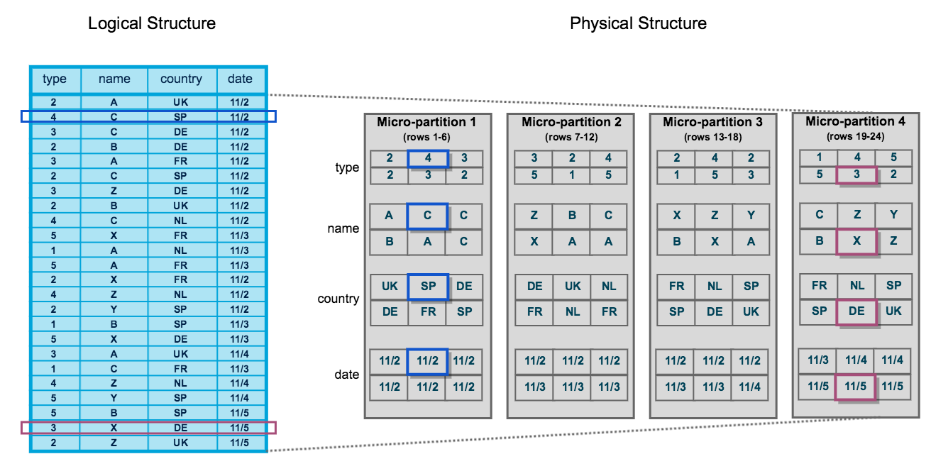
Micro Partition & Clustering
Static partitioning has well-known limitations like maintenance overhead and data skew, resulting in disproportionately-sized partitions.
Each micro-partition contains between 50 MB and 500 MB of uncompressed data
Columns are compressed individually within micro-partitions. Snowflake automatically determines the most efficient compression algorithm for the columns in each micro-partition.
Notes:
select get_ddl('table', 'mydb.public.salesorders’);
Temporary tables only exist within the session in which they were created and persist only for the remainder of the session.
This means you can create temporary and non-temporary tables with the same name within the same schema.
If the Time Travel retention period for a permanent table is set to 0, it will immediately enter the Fail-safe period when it is dropped.
Transient and temporary tables have no Fail-safe period.
Materialized views are automatically and transparently maintained by SnowflakeFor non-materialized views, the IS_SECURE column in the Information Schema and Account Usage views identifies whether a view is secure.
Snowflake does not allow standard DML (e.g. INSERT, UPDATE, DELETE) on materialized views. Snowflake does not allow users to truncate materialized views.

Slide 4
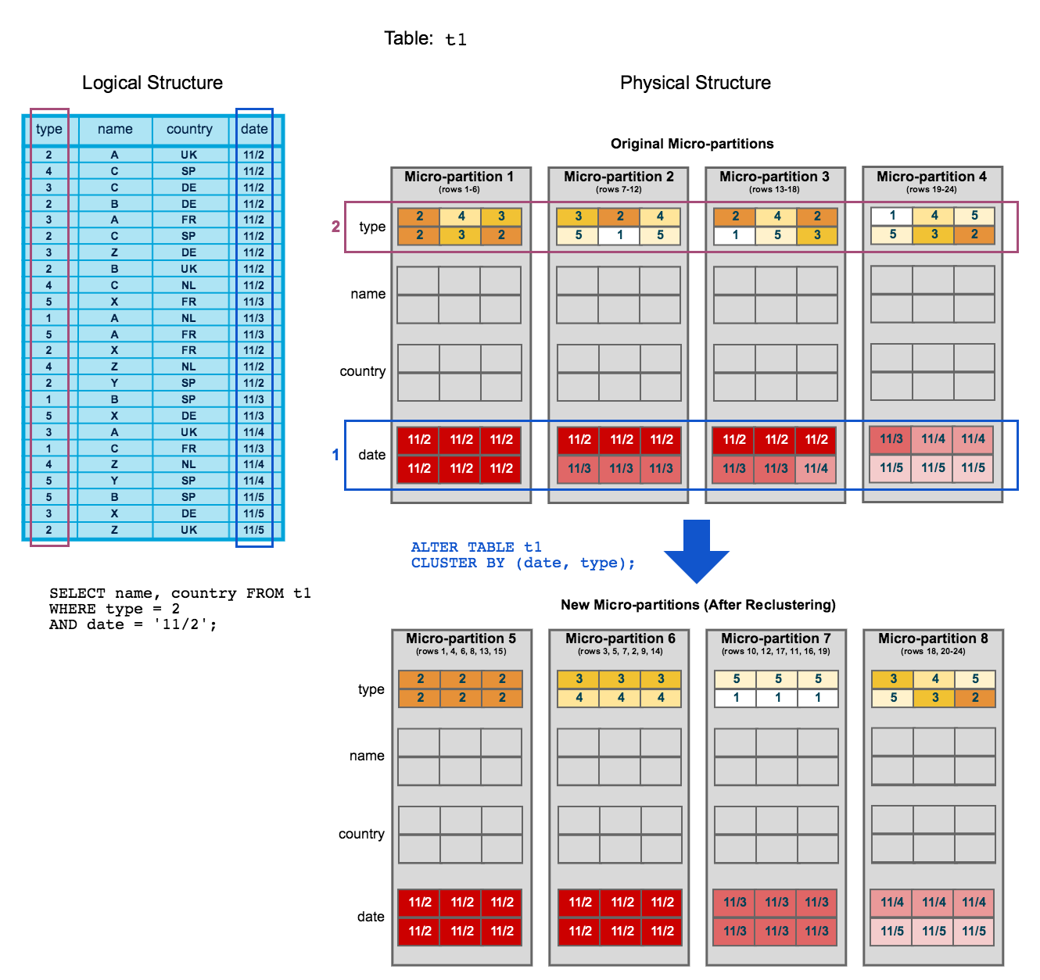
REClustering
Notes:
select get_ddl('table', 'mydb.public.salesorders’);
Temporary tables only exist within the session in which they were created and persist only for the remainder of the session.
This means you can create temporary and non-temporary tables with the same name within the same schema.
If the Time Travel retention period for a permanent table is set to 0, it will immediately enter the Fail-safe period when it is dropped.
Transient and temporary tables have no Fail-safe period.
Materialized views are automatically and transparently maintained by SnowflakeFor non-materialized views, the IS_SECURE column in the Information Schema and Account Usage views identifies whether a view is secure.
Snowflake does not allow standard DML (e.g. INSERT, UPDATE, DELETE) on materialized views. Snowflake does not allow users to truncate materialized views.

Slide 5
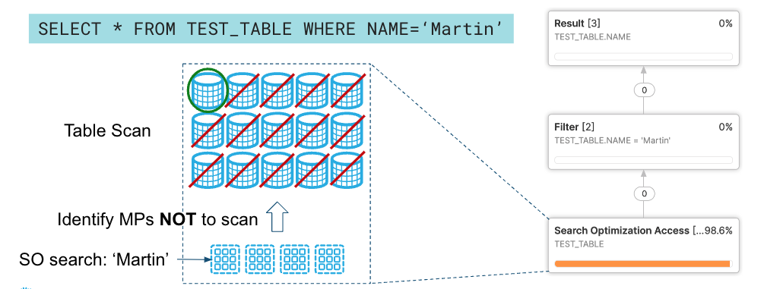
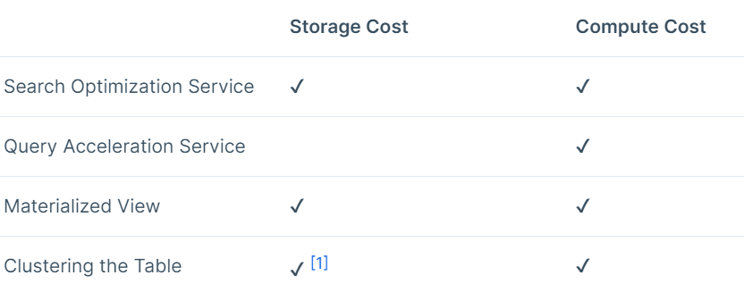
Query optimization Techniques
Search Optimization
Materialized Views
Query Acceleration
Clustering a table
Search Optimization

Slide 6
LAB

Slide 7
Security
Choose the level of security you require for your snowflake account, based on snowflake edition.
Choose the geographical location where your data is stored, based on your Snowflake Region.
User authentication through standard user/password credentials.
Enhanced authentication using
MFA
Federated authentication and single Sign On
All communication between clients and the server protected through TLS
Deployment inside a cloud platform VNet/VPC
Isolation of data via cloud storage policy controls
Support for PHI data ( in compliance with HIPPA regulations ) - requires Snowflake Enterprise for Sensitive Data (ESD)
Automatic data encryption by snowflake using snowflake managed keys.
Object Level access control
Snowflake Time Travel
Snowflake Fail-safe

Slide 8
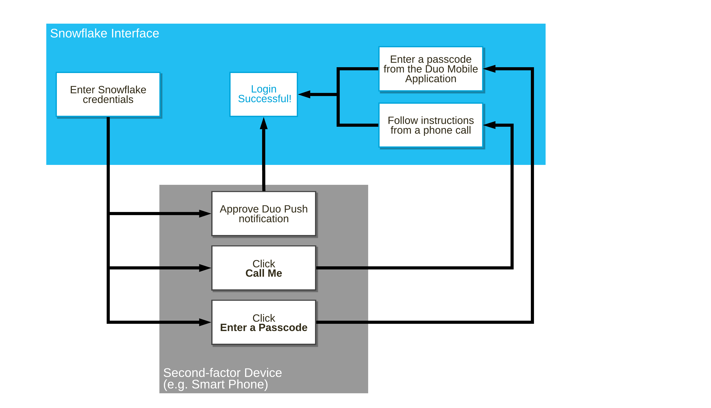
MFA & SSO

Slide 9
Data Access Policy
Dynamic Data Masking
Row Based Access
LAB

Slide 10
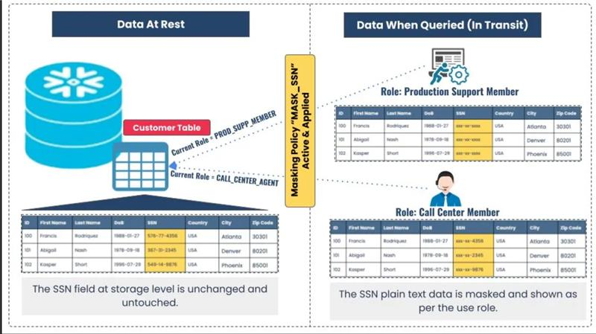
DYNAMIC Data Masking

Slide 11
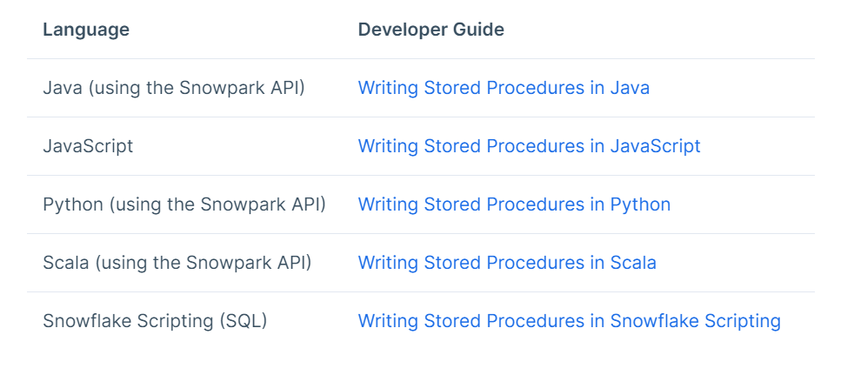
Stored Procedures and UDFs
Supported Languages

Slide 12
Pricing
Pricing Guide | Snowflake

Slide 13
Thank You

